Slide 1
SQL : Additional Notes

Slide 2
LIKE operator
WHERE FirstName LIKE '_im' finds all three-letter first names that end with 'im' (e.g. Jim, Tim).
WHERE LastName LIKE '%stein' finds all employees whose last name ends with 'stein'
WHERE LastName LIKE '%stein%' finds all employees whose last name includes 'stein' anywhere in the name.
WHERE FirstName LIKE '[JT]im' finds three-letter first names that end with 'im' and begin with either 'J' or 'T' (that is, only Jim and Tim)
WHERE LastName LIKE 'm[^c]%' finds all last names beginning with 'm' where the following (second) letter is not 'c'.

Slide 3
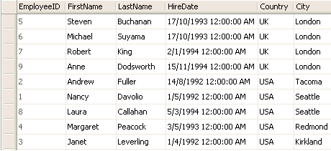
ORDER BY Operator
SELECT EmployeeID, FirstName, LastName, HireDate, Country,
City
FROM Employees
ORDER BY Country ASC, City DESC
*(DESC - from highest to lowest value)
*(ASC – from lowest to highest value)

Slide 4
UNION Operator
The UNION operator is used to combine the result-set of two or more SELECT statements.
Each SELECT statement within the UNION must have the same number of columns. The columns must also have similar data types. Also, the columns in each SELECT statement must be in the same order.
The UNION operator selects only distinct values by default.
SELECT column_name(s) FROM table1 UNION SELECT column_name(s) FROM table2;

Slide 5
Practicing with SQL
http://www.w3schools.com/sql/default.asp

